Slide 1
Deep Cancer Detection
Final Project by Muf Tayebaly (mt3195)

Slide 2
Agenda
About the project
Data Samples
Data Preprocessing
Modeling
Training Results
Test Results
Conclusion

Slide 3
About the project

Slide 4
Project Information
This project focuses on improving the detection of cancer cells in pathology images. The detection normally is conducted by a pathologist looking at magnified images and eyeballs whether certain cells are cancerous.
The manual mistake of a person can cause for bad diagnosis and so this project helps reduce that error rate.
In order to do this, we will be using Deep Learning to train a model on the CAMELYON16 dataset to help identify if areas of the images have cancer cells.
The CAMELYON16 dataset has images of samples taken from cancer patients and where pathologists have already identified areas where cancer cells are. I will use this data to train, validate and test the model.

Slide 5
Data Preprocessing

Slide 6
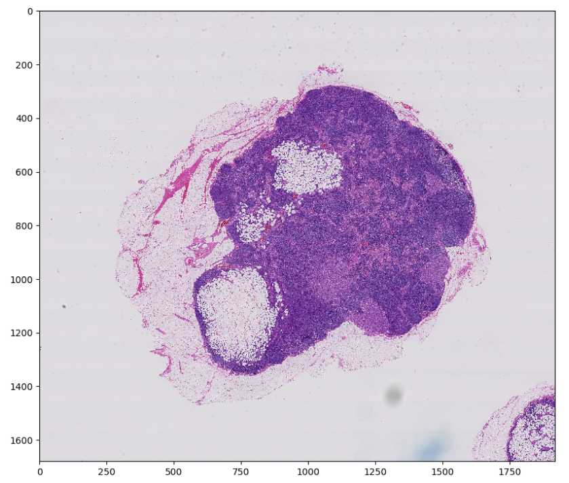
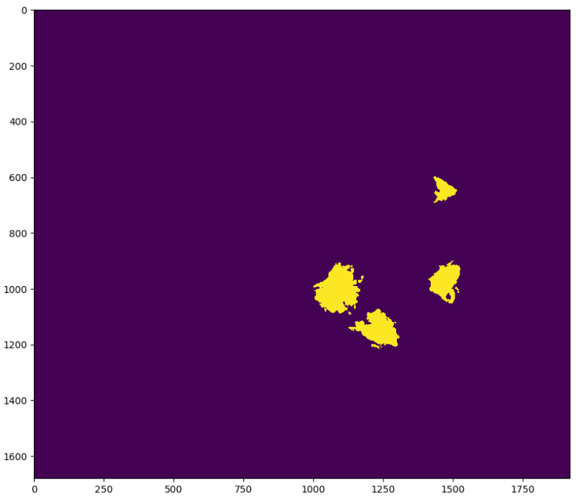
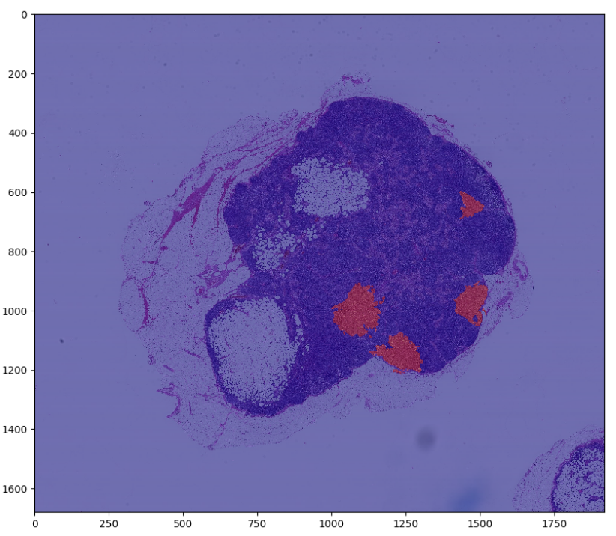
Preview the Dataset
The data consists of very large images of the sampled areas and another image that shows the areas identified as cancer. There are also different levels of each image. See below samples of the data for tumor_091 at level 5:
tumor_091 normal image with H&E
tumor_091 cancer mask
Heatmap of cancer on the tumor image

Slide 7
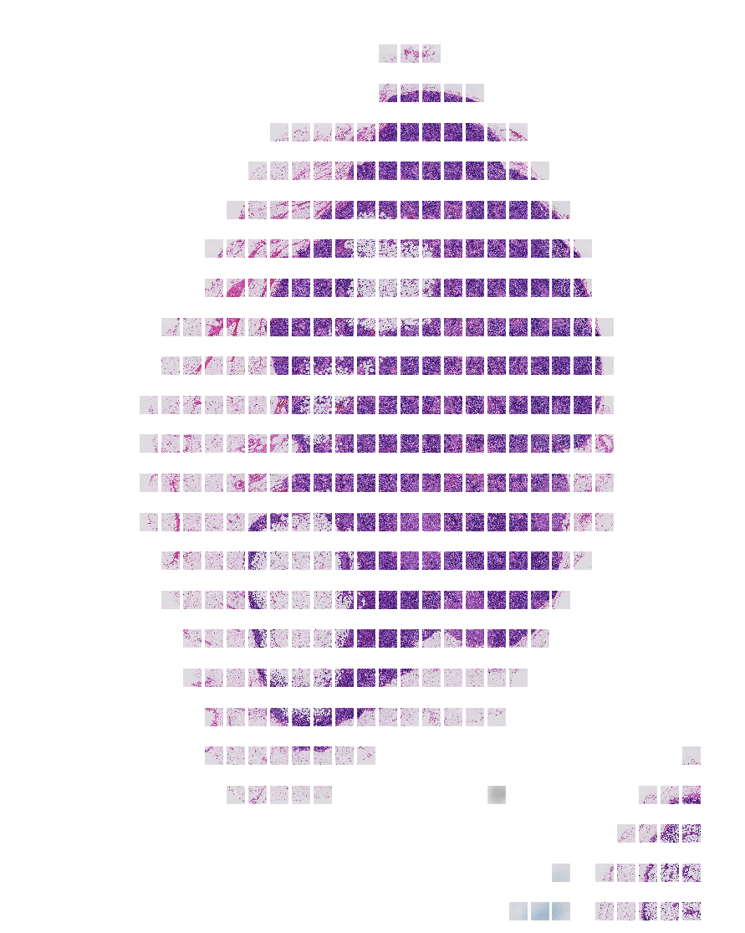
Ignoring Grey Areas – Training Efficiency
As you can see the image has a lot of space that does not contain any issue. Also, since the image is too large to train, we can use smaller patches of the images and use this opportunity to ignore the non-tissue containing patches.
After I slide through the image with a window of 128 x 128, I only keep the patches with 5% of tissue or more and as you can see, we get a much better set of data and remove all the grey space.
Creates a total of 338 patches for this tumor slide containing at least 5% tissue
tumor_091 normal image with H&E

Slide 8
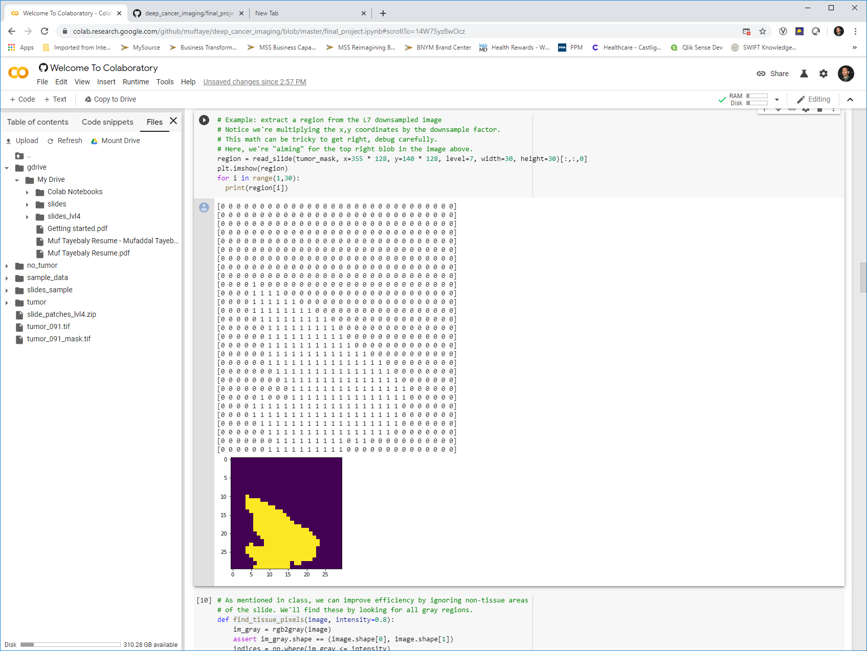
Creating the Training Set
Now that I can get the patch images, I can do the same with the mask images and determine if that patch contains cancer or not.
This is done by looking at the mask region and identifying if there is even one pixel of cancer. If there is, we classify as a cancer tumor vs no cancer tumor. This is just a simple sum of the mask matrix as shown below:
The patch matrix we sum to identify if a cancer patch
tumor_091 cancer mask in yellow

Slide 9
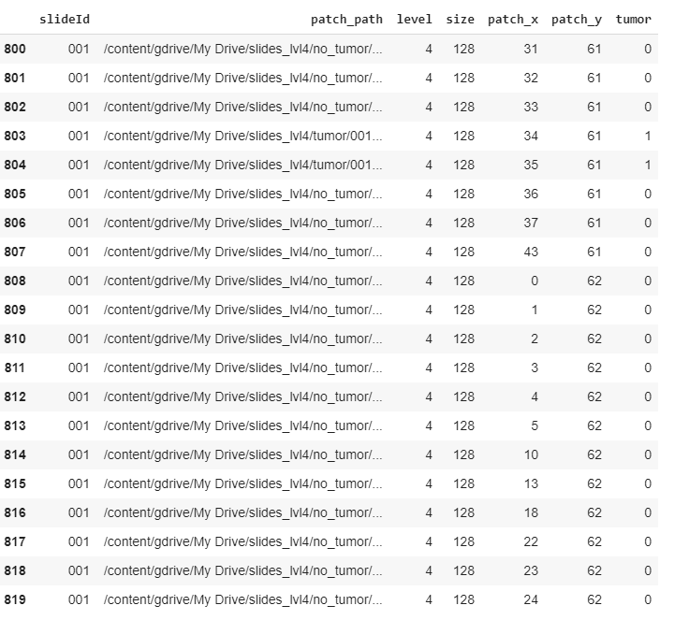
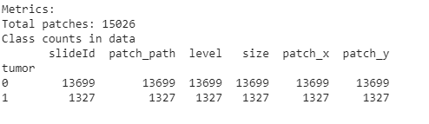
Creating the Training Set
At level 4 of the tumor images, we are able to convert all the images (except slide 099 and 038 due to missing images). We then get a training dataset as sampled below. As the metrics show, there are 15026 patches, but only 1327 of them are cancer tumor containing.

Slide 10
Creating Train / Validation / Test Data
Since I will be testing the data on 3 images, I randomly choose 3 images to pull all the data on for a complete testing. This way I have all the patches and masks, and will be able to compare the prediction on the truth with full heatmaps.
After I get the test data which contained 147 cancer containing tumors, I have 1180 left. So I need to balance the data.
This is done by randomly choose 1320 non-cancer containing tumor patches. This will give me 2500 patches to train and validate on.
I then do a 80/20 split for train and validation, which gives me the below breakdown and structure of my data ready to model.
4684 Sample Patches - Level 4
Train 2000 patches
Validation 500 patches
Test 2184 patches
Cancer
No Cancer
Cancer
No Cancer
Cancer - 147
No Cancer - 2037

Slide 11
Modeling

Slide 12
Base Model – Simple Low Parameter
This is in progress.
Idea:
Create a simple DNN to see what type of results we are getting and to use as a base.
Then create a couple CNNs (one using InceptionV3) and compare results to DNN. Adjust some hyperparameters to see if that helps.
Potentially look at using 2 zoom levels.. Need to see how this would work.

Slide 13
Training Results

Slide 14
Training Results
This is in progress.

Slide 15
Testing Results

Slide 16
Testing Results
This is in progress.

Slide 17
Conclusion

Slide 18
Conclusion
This is in progress.

